Slide 1
B2B & B2C product integration
TEAM ENTHUSIASTS
-
Alexandra Poterasu
chi nguyen
phung le

Slide 2
Definition of the concept, purpose of the application or service
Concept definition: B2B & B2C E-commerce Promoting and Selling Products Integration
Purpose:
"Photoshop" furniture into the room but with more options, less hassle, and no collaging skills/software necessary
Improve furniture visualization intuitively and effectively, ultimately boosting online sales
Increase the business value of a company by expand their digital marketing strategy

Slide 3
Target group, what different type of users
Two types of users, with a focus on the second:
B2B (companies acquiring the platform in order to promote and sell)
B2C (customers of the certain companies that would utilise the platform as an e-commerce option, in order to visualise the products and buy them)
Example: The customers could evaluate how well does the furniture from Ikea fit with their space and preferences and acquire it through a personal account; if it does not fit, they can request a customised design.

Slide 4
Benefit to the user
B2C (customers of the furniture sellers – main focus):
Acquiring standard products via the platform’s offer
Visualising and sharing the products’ design and how they would fit in the real space through the presets
Creating their own designs and ordering customised furniture based on them
B2B (furniture business providers):
Promoting the products after paying for a company account
Illustrating in detail the available designs/catalogue offer
Selling the furniture through the e-commerce platform

Slide 5
Main functionalities & structure of the service
Comfortable design, easy to navigate website
Easy-sharing pictures buttons
B2C (main)
Seeing more detailed information of the product
Custom furniture, easy-to-share ideas
Room type presets / templates
Adding chosen products to cart
Adding floors
B2B (secondary)
Categorizing products
Adding new products

Slide 6
possible user personas
Emily, a business student, represents target users who are motivated to change the look of a space. For the first time, Emily is getting her own apartment and needs to furnish it. She is looking for quality on a budget. She is concerned about finding a sofa that fits in her narrow living room and a single bed that fits in her bedroom too.
Alex, CEO of a furniture selling company, represents target users who are aiming in developing a new selling method in the industry in order to improve the company's digital marketing strategy. He is looking for an online platform where his customers not only to have a possibility to customize their interior ideas using the application, but also be able to add those chosen items to the shopping basket and make the purchase immediately and directly whenever customers are ready. (secondary plan)
John, a blossoming interior design student, represents target users who are motivated to explore new interior design ideas every day. He is seeking to an application where he can practice and translate his passion for design into every space he works on. He approaches each project as a puzzle, and believes his job is to create the pieces that blend beauty, function and practicality, reflecting on the best possible look for the budget, way of life, and specific measurements of the location.

Slide 8
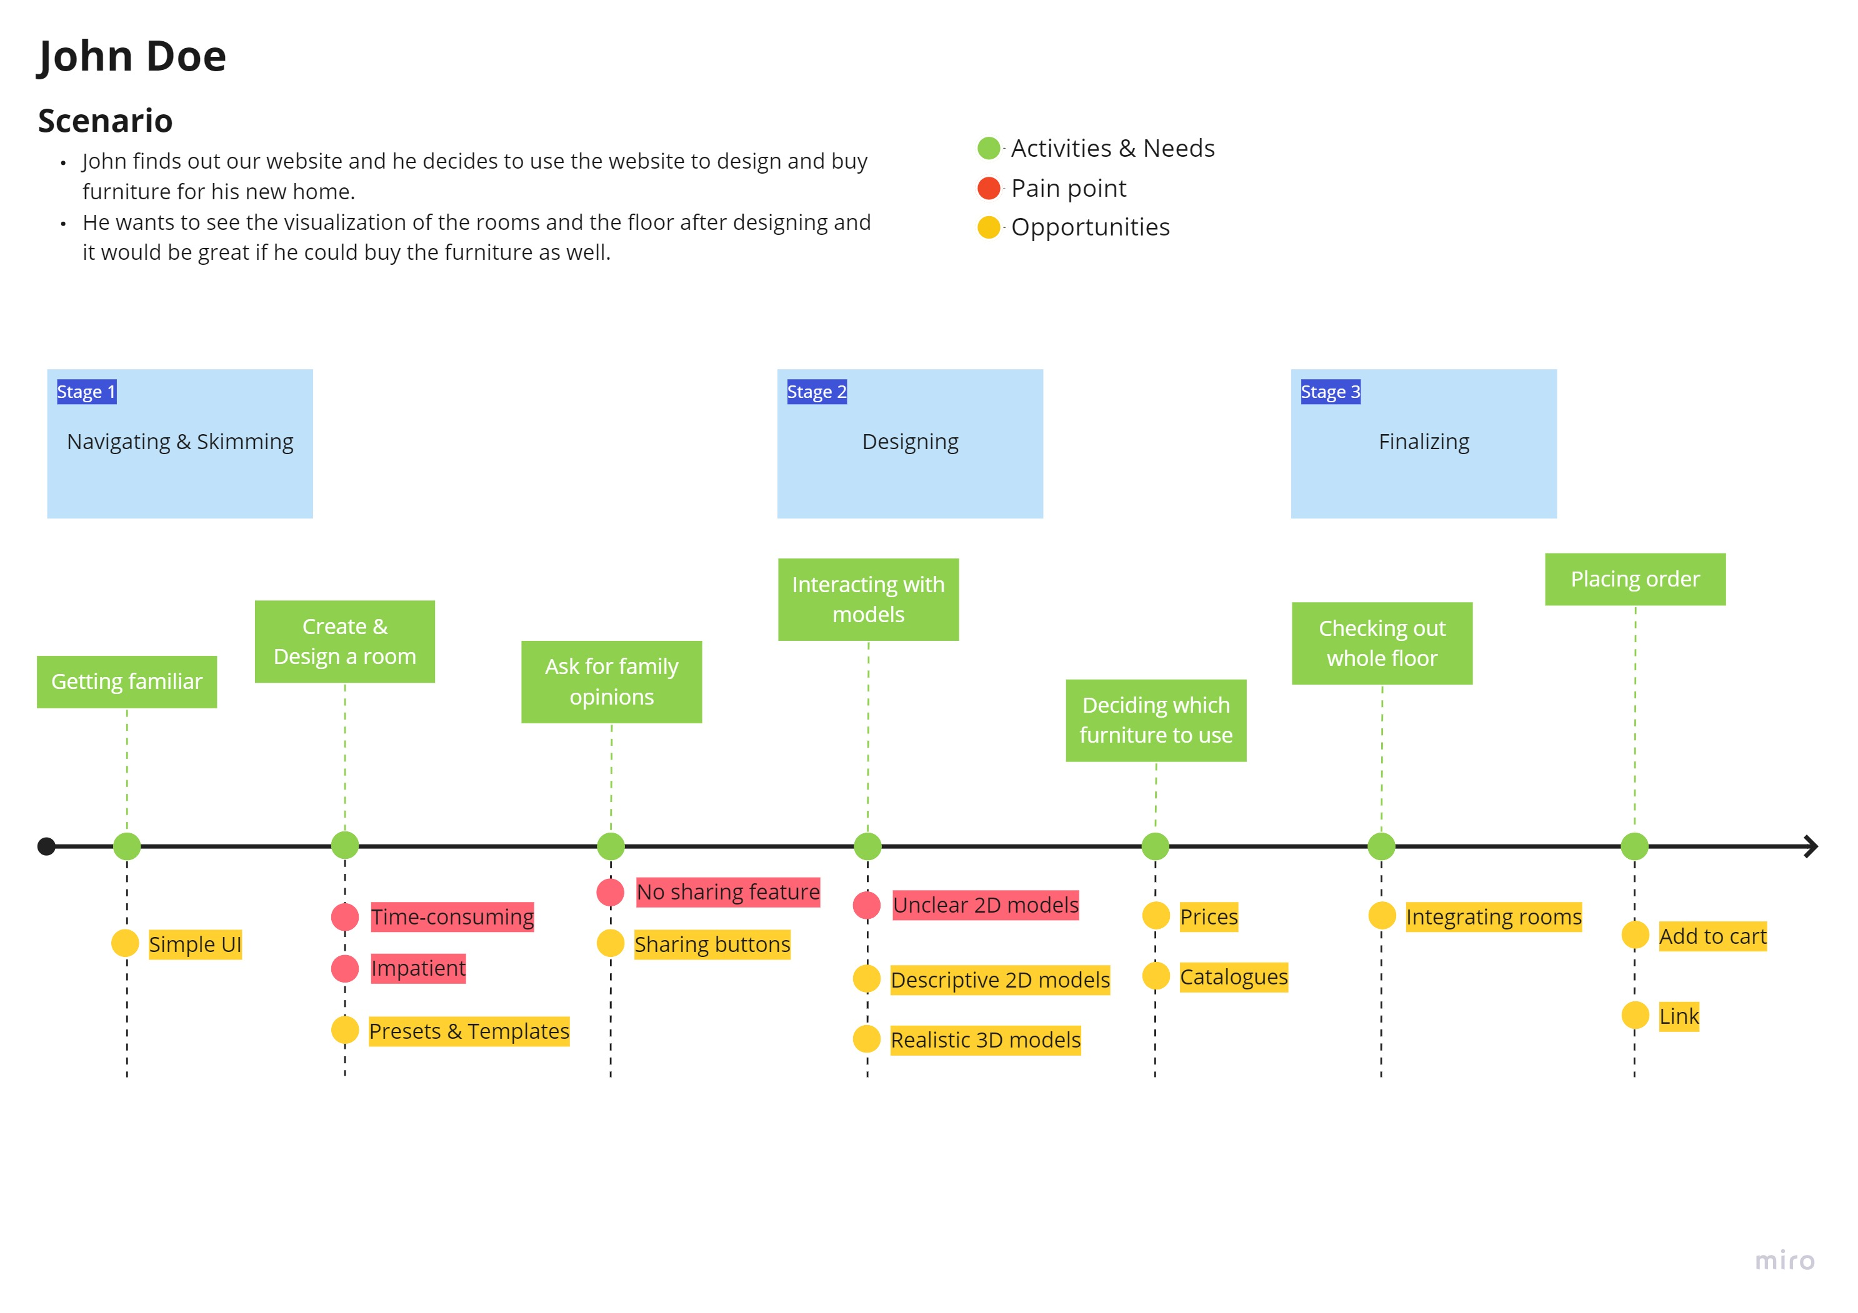

Slide 9
scenario
John, a Business Administration student, will move with his family to a new apartment. As he is more familiar with technology than his parents, his mom asked him to help in selecting and purchasing furniture. As they live on a relatively limited budget, it is important for him to be able to choose from a range of affordable options.
John is not a specialist in the field, but he knows that he wants minimalistic, but nice furniture that would not be very expensive, but would fit well. As he is willing to spend time on selecting the furniture and buying it, he logs in on the platform and starts with creating a room based on the offered presets, then interacts with the offered models and decides on the ideal options depending on the quality-price ratio. Further on, he proceeds with the whole floor. Despite the fact that John is a relatively impatient type of person, the platform fits hist taste, as it is easy to use and fast to work with.
As John uses social media a lot, trends and others’ opinions influence him a lot. For this reason, he uses inspirational images found online in his mission of virtually furnishing the new place. Also, after deciding on the final layout for the rooms and the ideal designs, he uses the share function to ask for his relatives’ and friends’ opinions. After he gets positive reviews he is satisfied to know that the last hours were spent in a practical way and that he managed to find what he needed, so he adds the products to the cart and pays for the sent order.

Slide 10
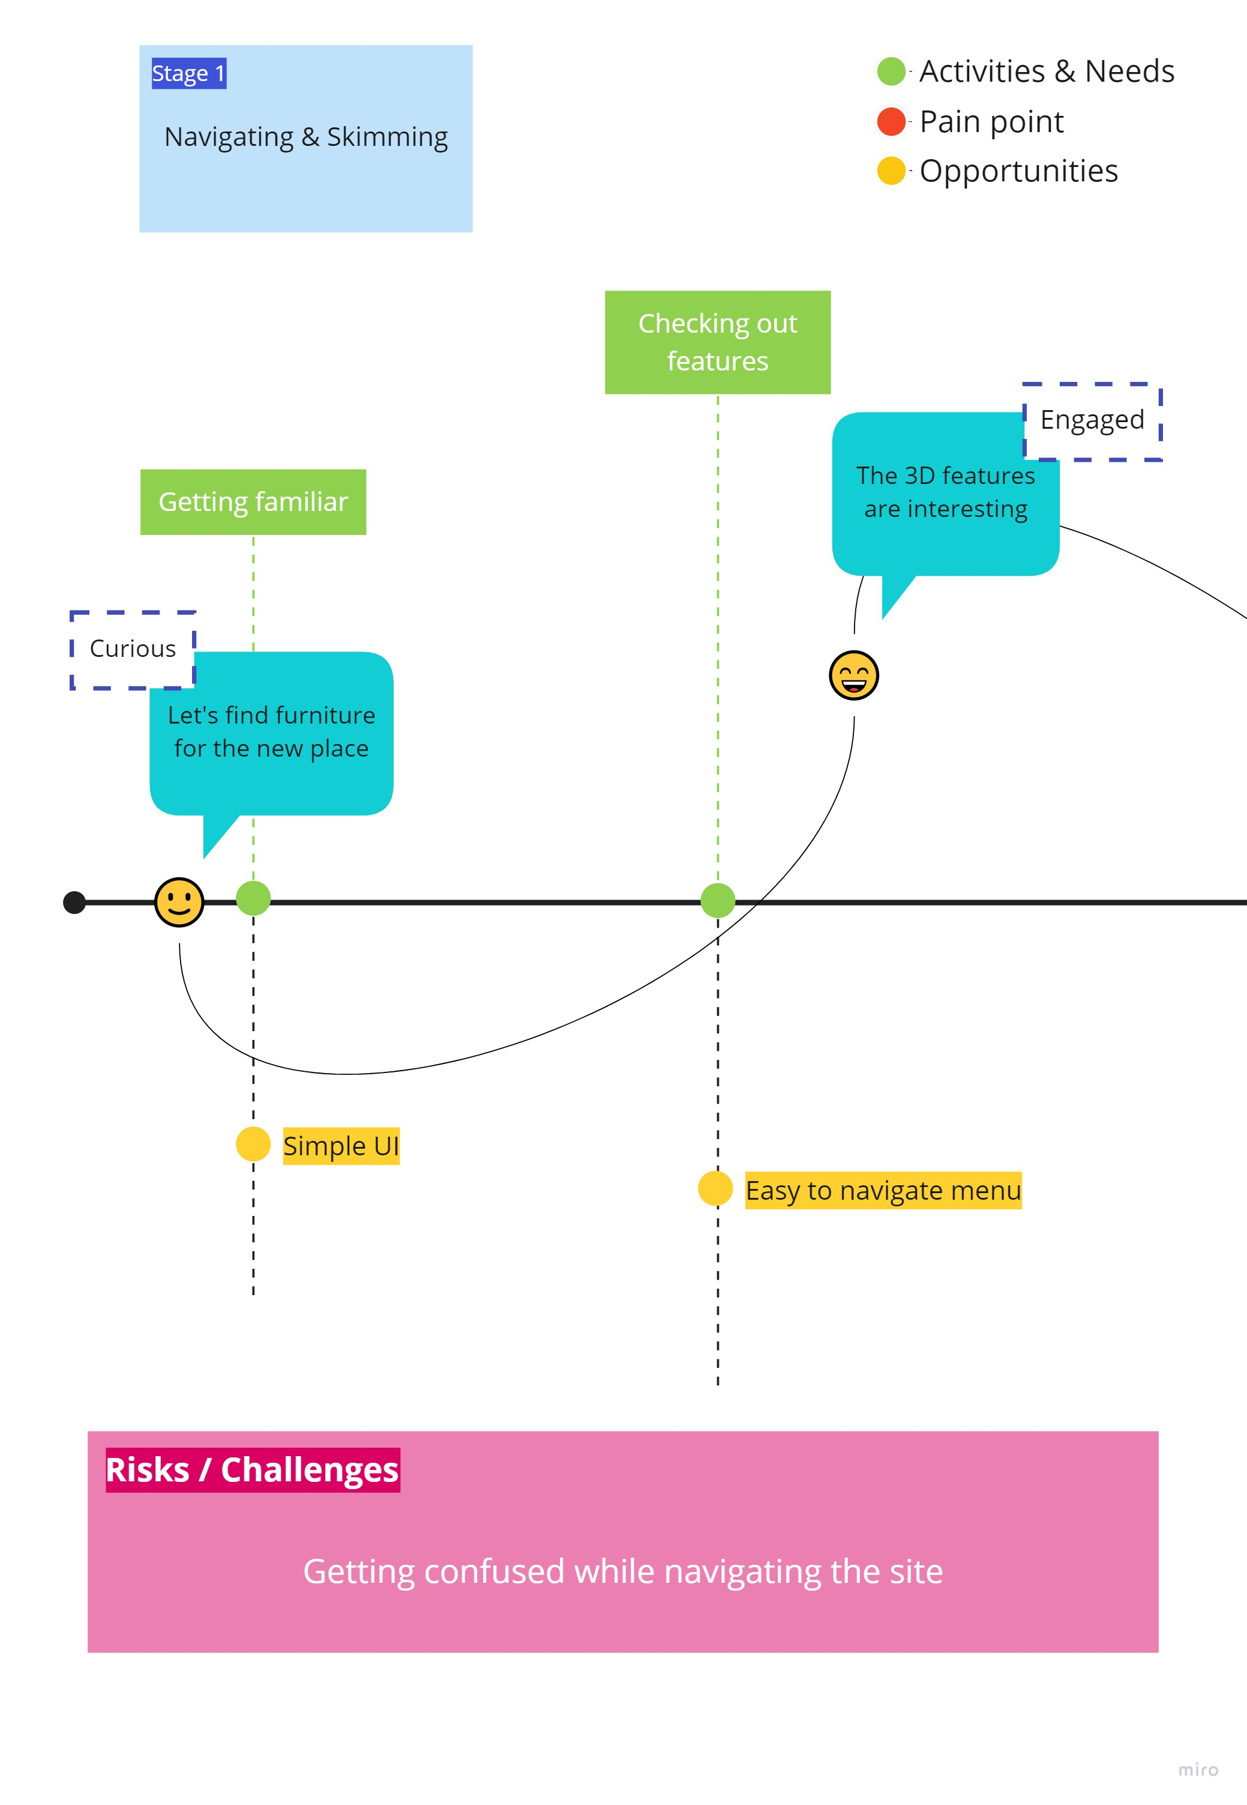
Refined journey map – STAGE 1

Slide 11
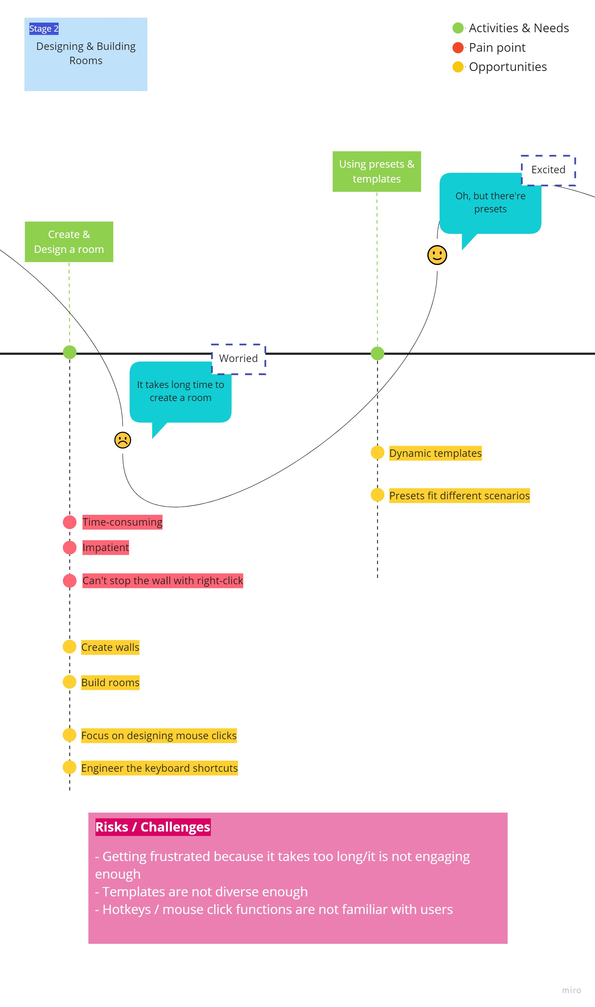
Refined journey map – STAGE 2

Slide 12
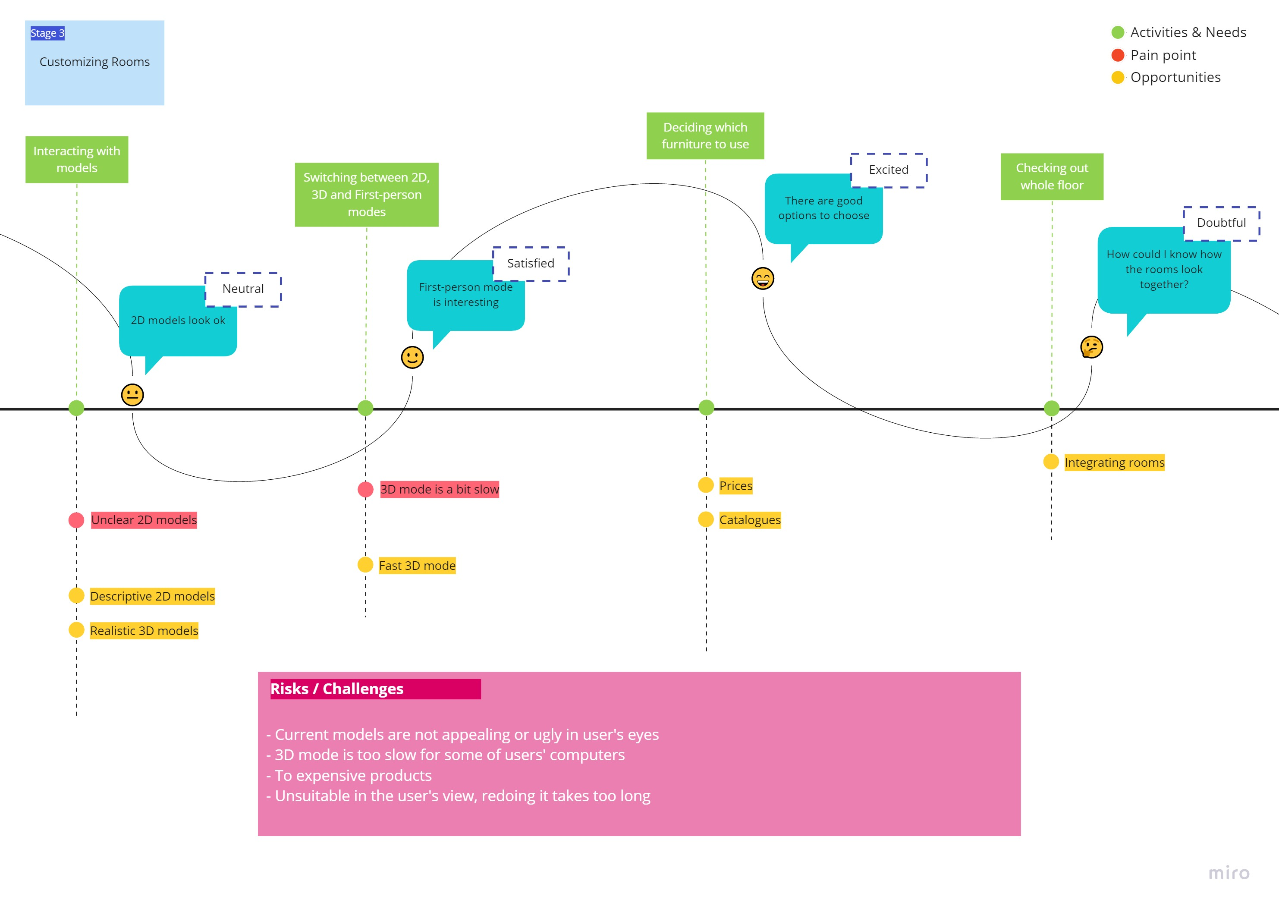
Refined journey map – STAGE 3

Slide 13
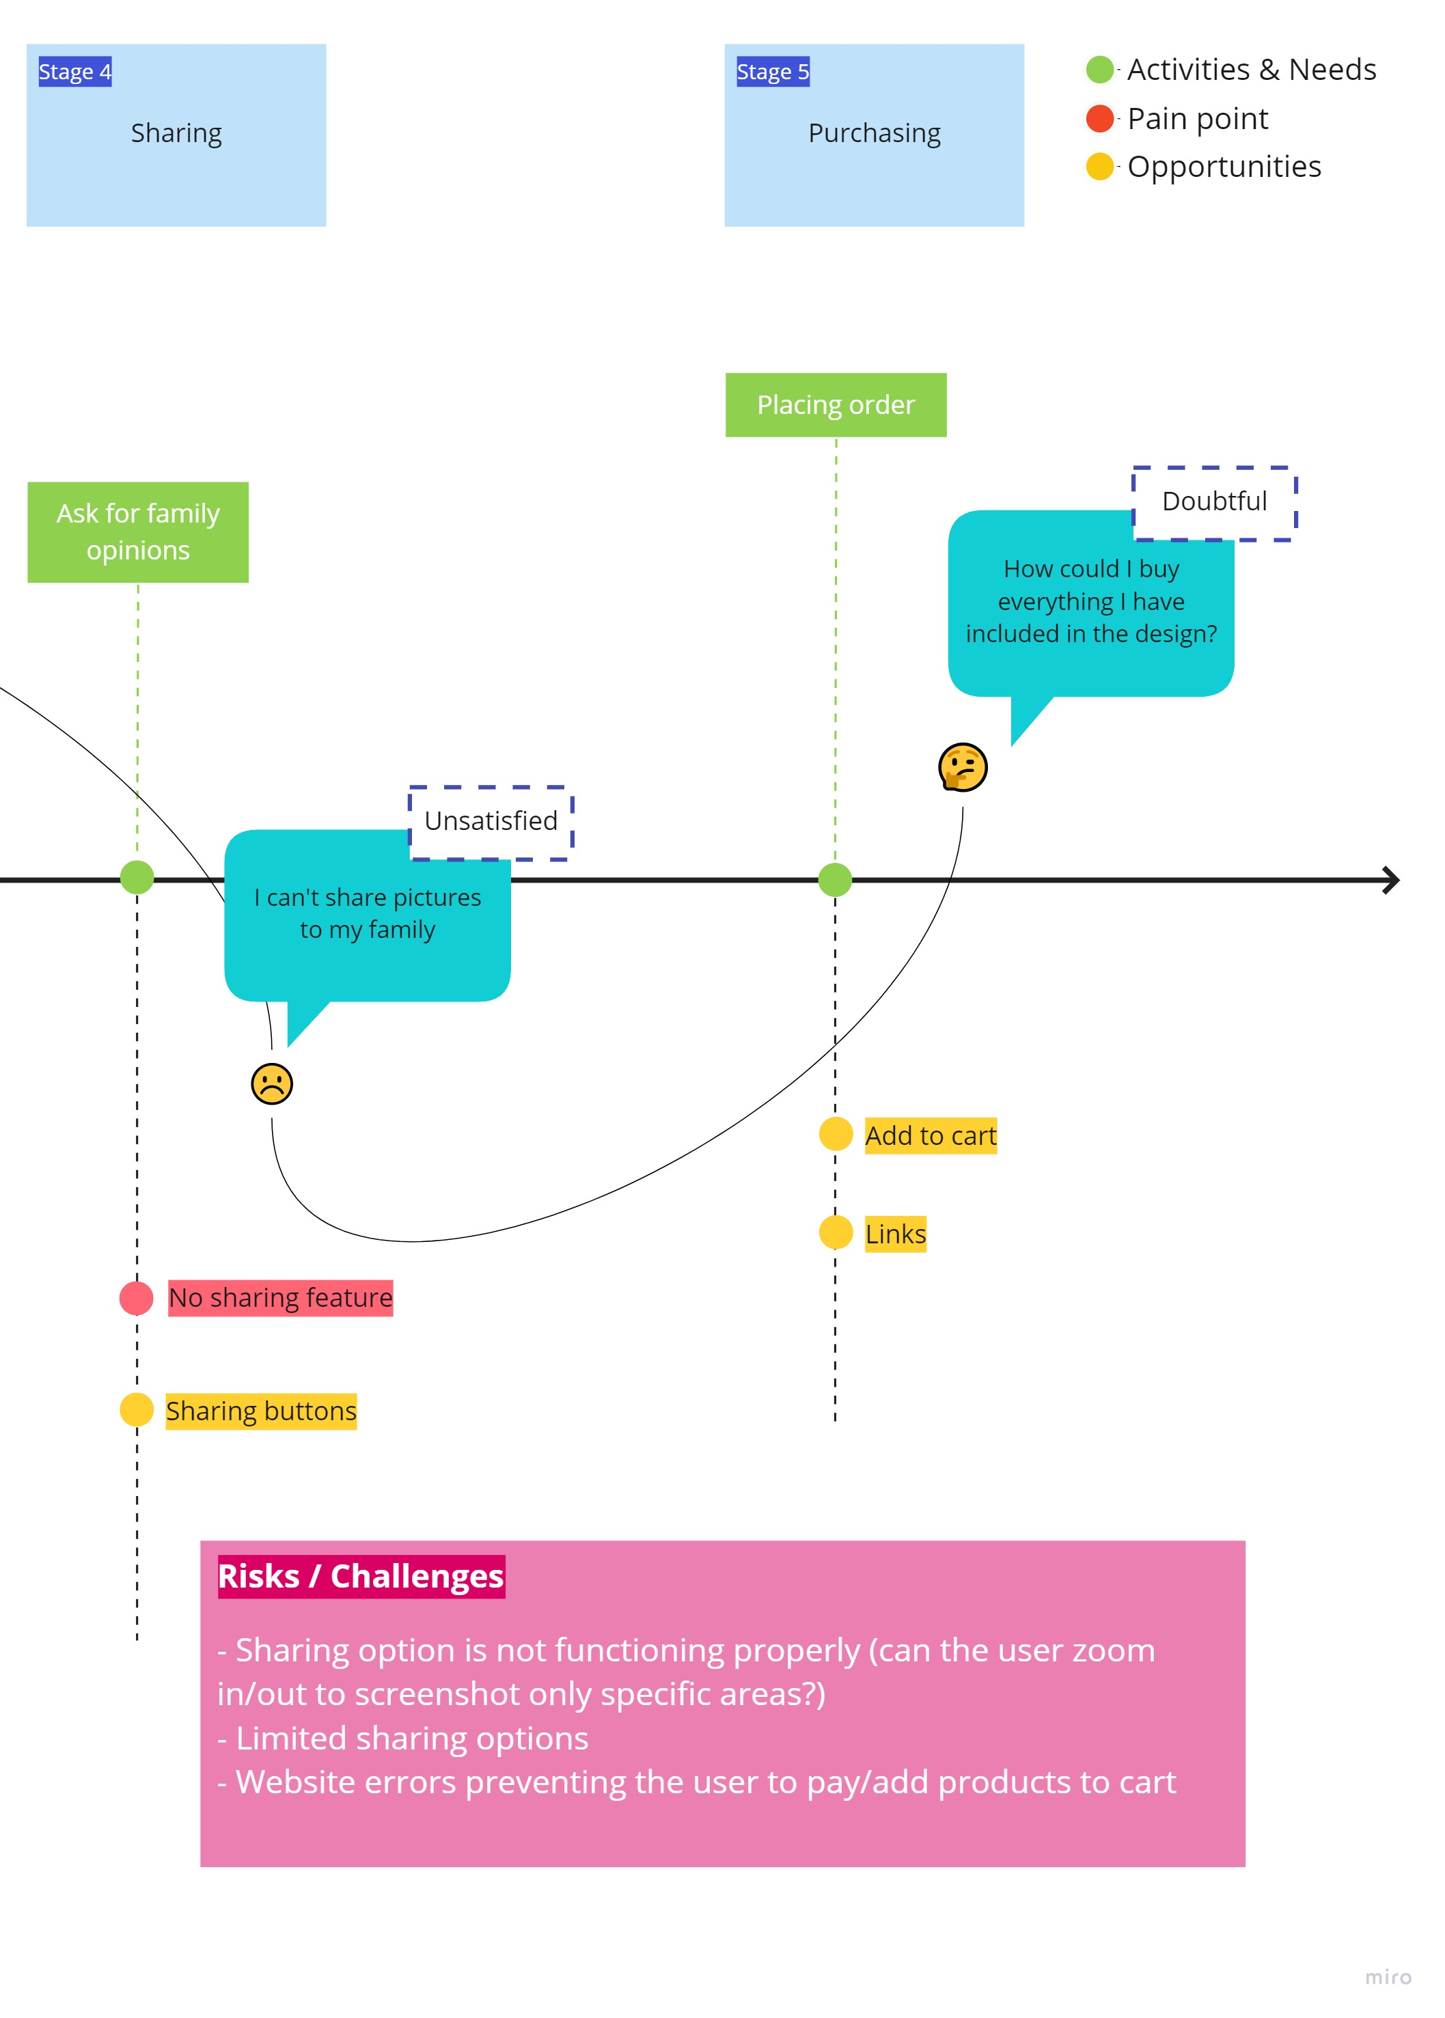
Refined journey map – STAGE 4 & 5
https://haagahelia.sharepoint.com/teams/DigitalServiceDesign71/Shared%20Documents/General/DSD%20Journey%20Map%20-%20New.jpg?web=1

Slide 14
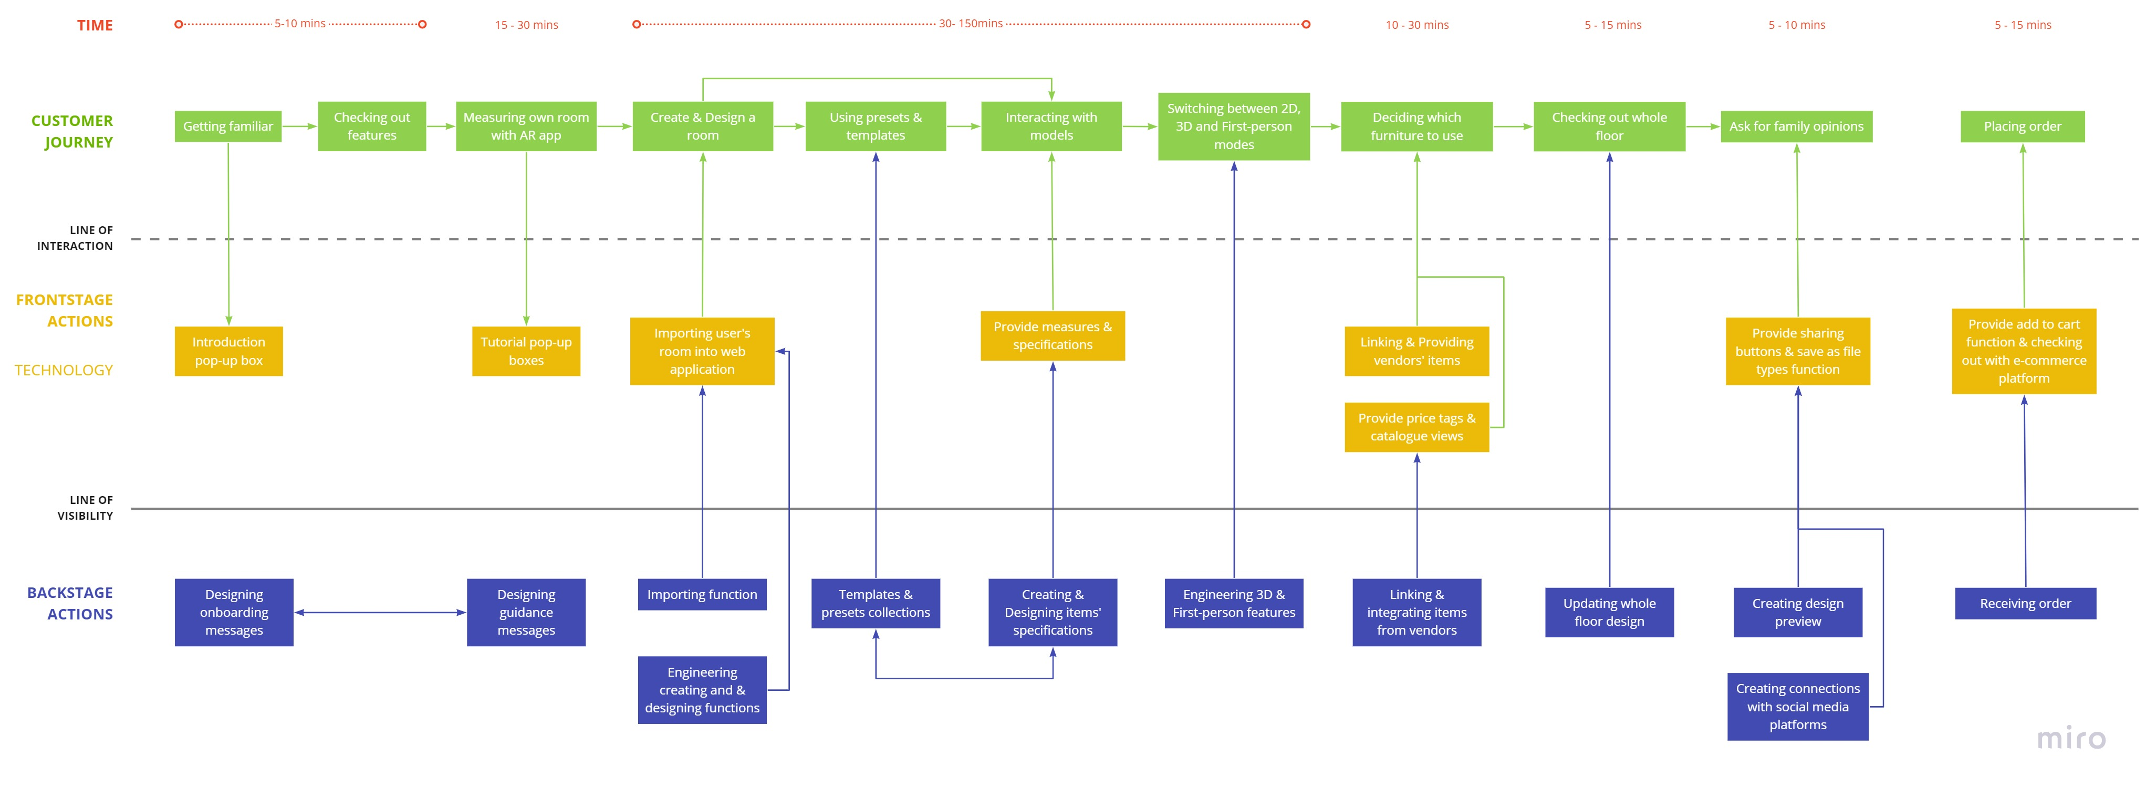
SERVICE BLUEPRINT
https://haagahelia.sharepoint.com/teams/DigitalServiceDesign71/Shared%20Documents/General/DSD%20Service%20Blueprint.jpg?web=1

Slide 15
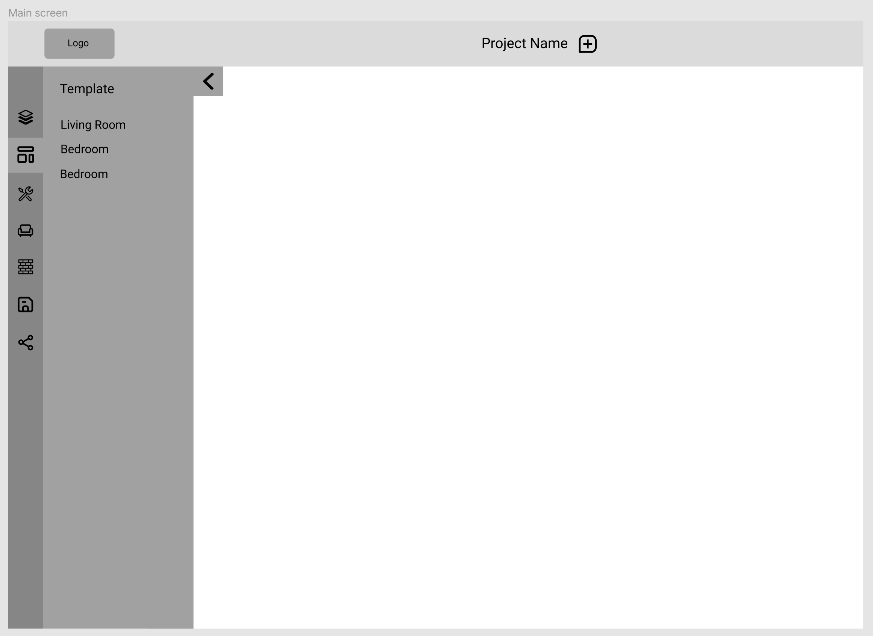
Low-fidelity Design

Slide 16
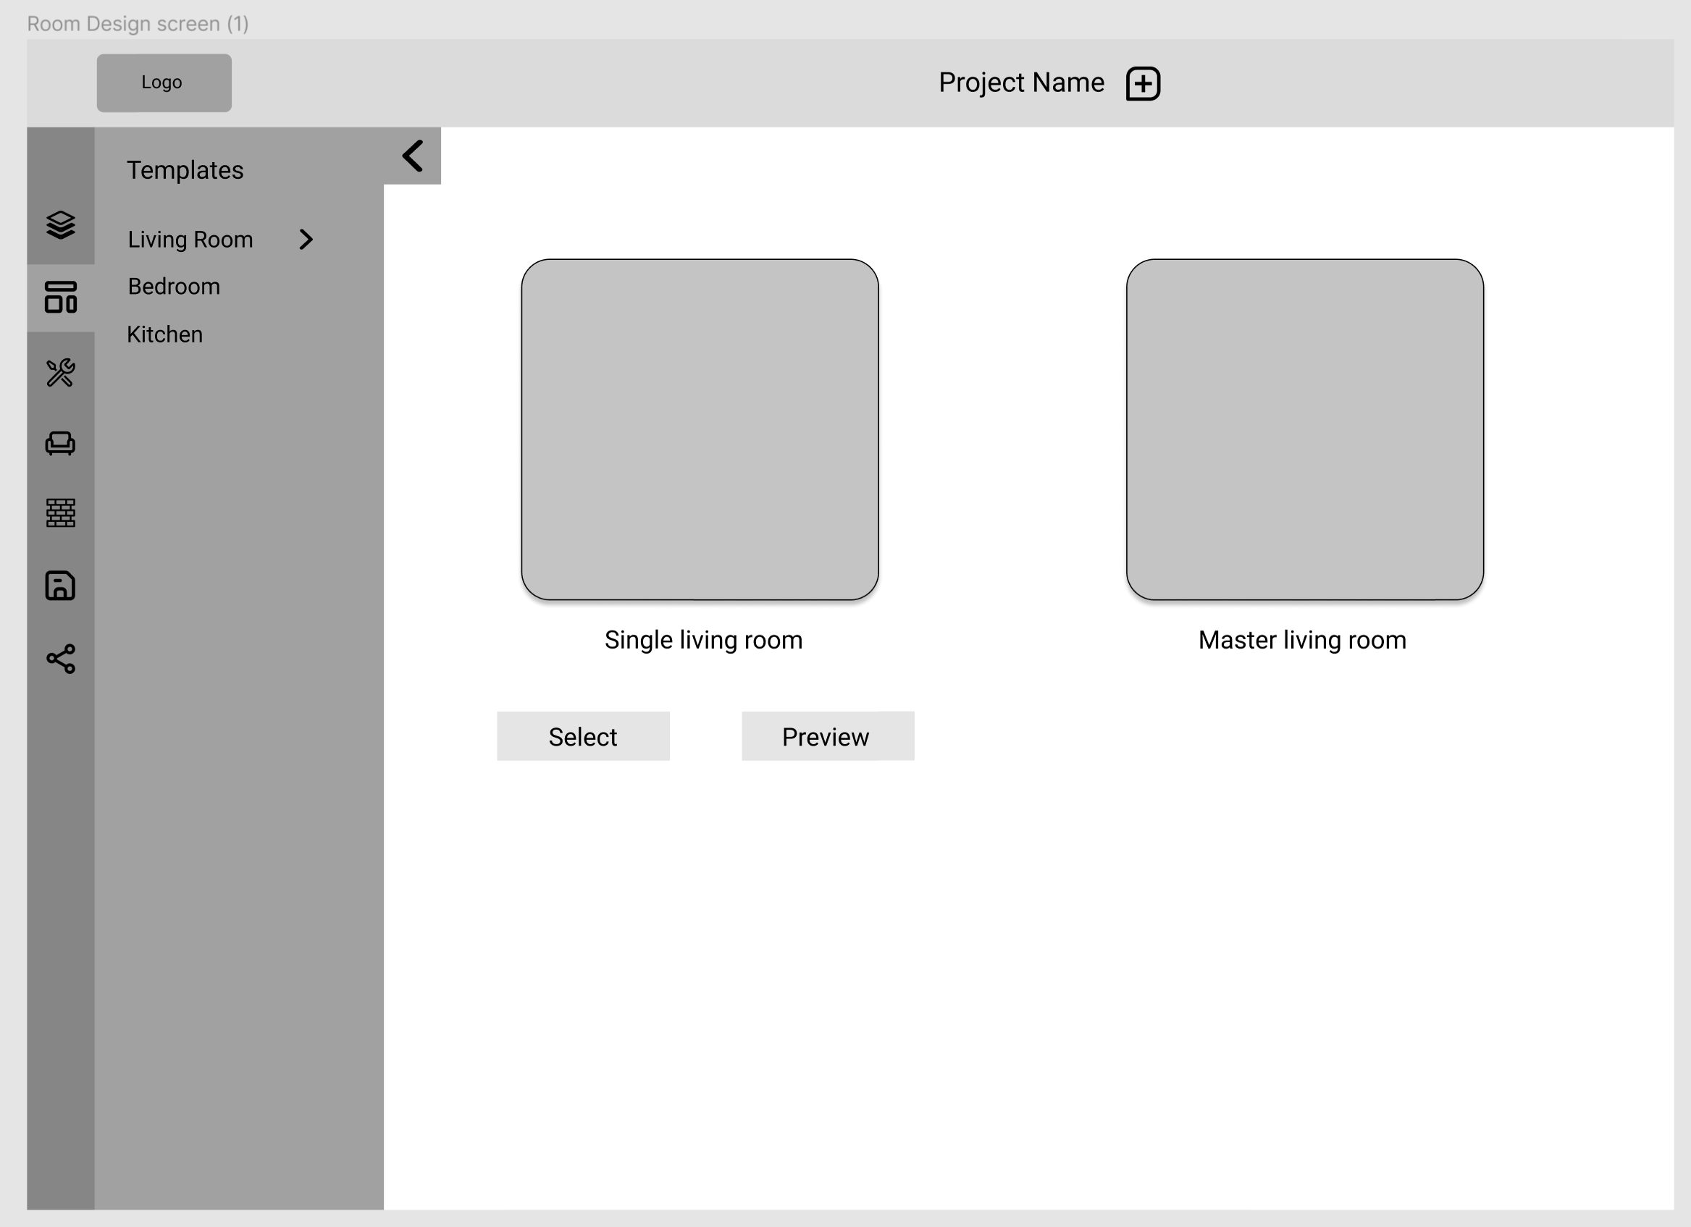
Low-fidelity Design

Slide 17
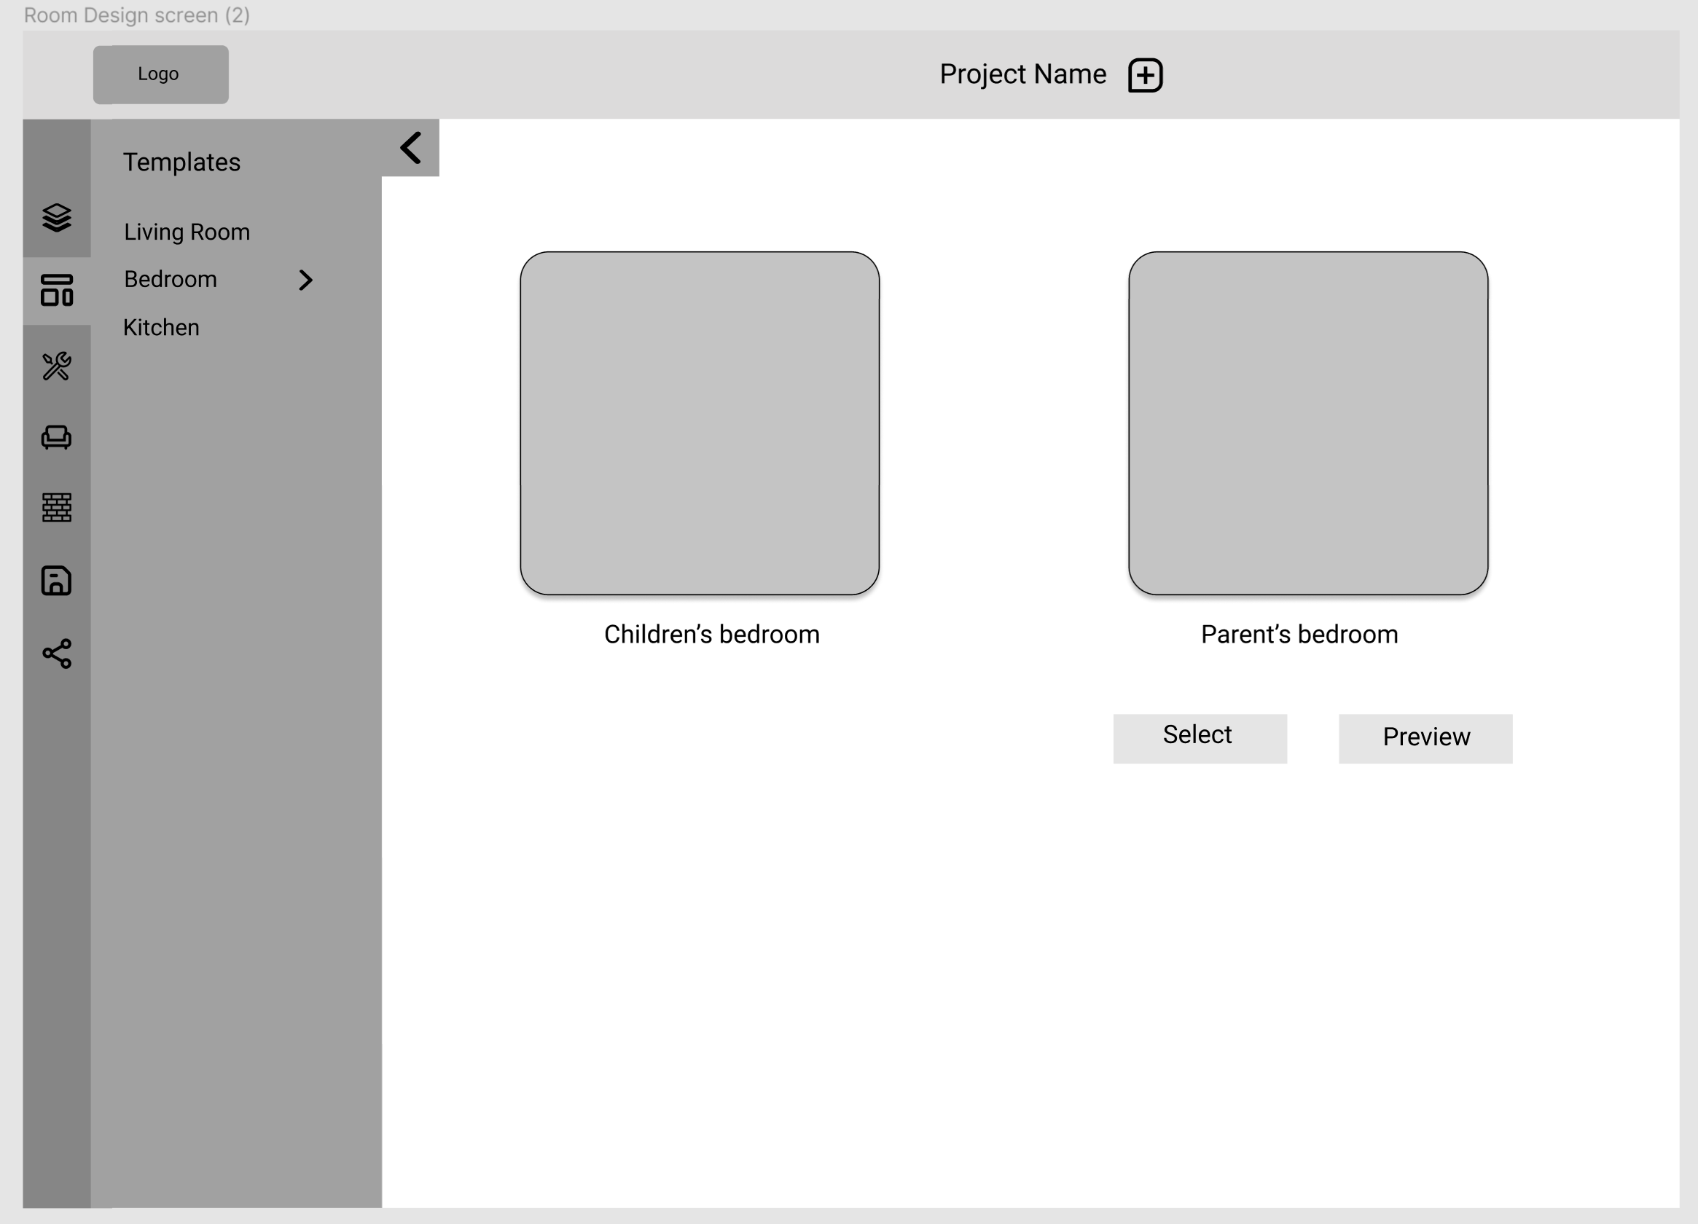
Low-fidelity Design

Slide 18
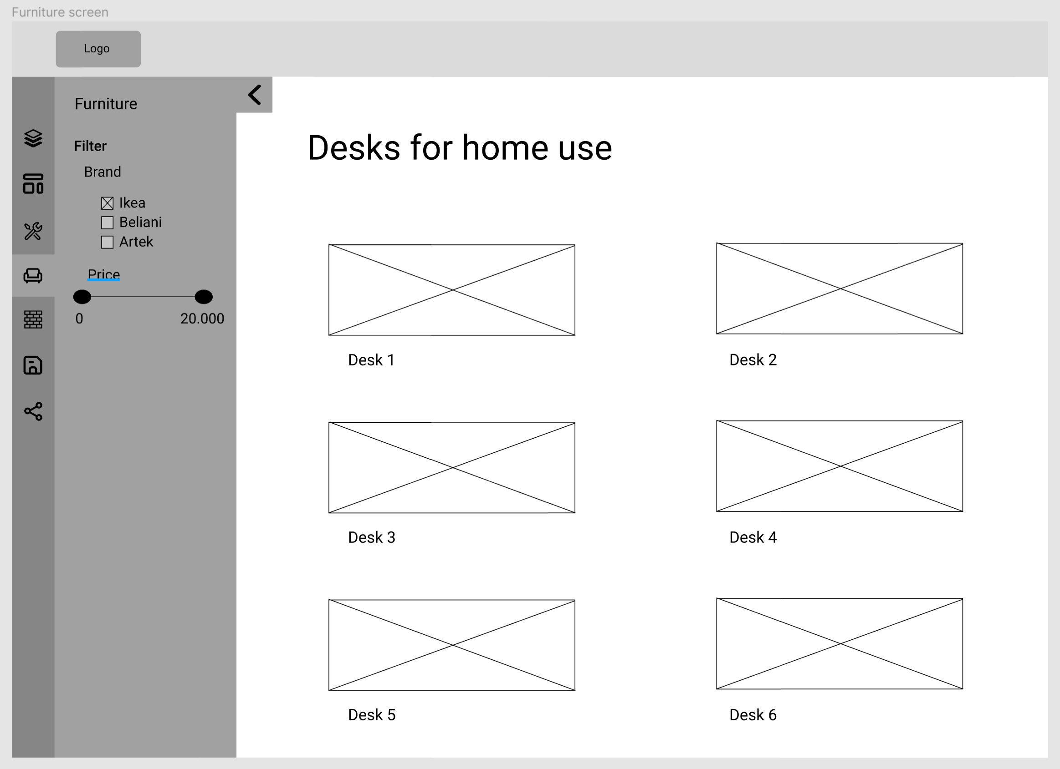
Low-fidelity Design

Slide 19
Low-fidelity Design
https://www.figma.com/proto/WQVKc21cDbXNzj4D6Or4C0/Ainak-Low-Fidelity?node-id=1%3A2&scaling=scale-down&page-id=0%3A1

